Slide 1

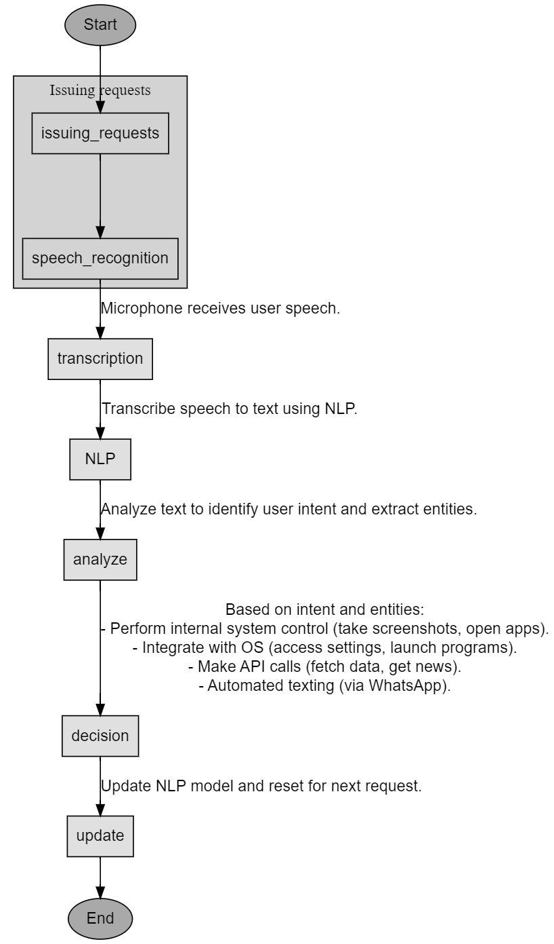
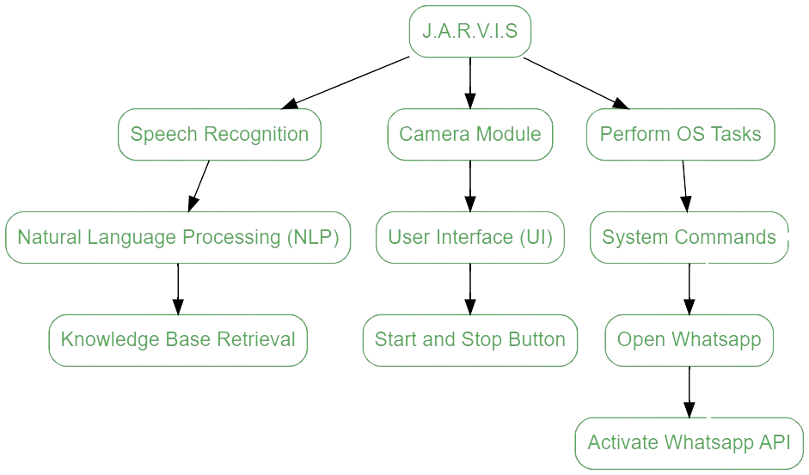
Sardar Patel Institute of Technology
Department of Computer Engineering
Academic Year 2023-24
Title: JARVIS – THE VIRTUAL ASSISTANT
Names: MAYUR SOLANKAR, MANISH JADHAV, VISHESH SAVANI - B.Tech.(Comp.)
Project Guide : DR. PRASENJIT BHAVATHANKAR
Abstract
The JARVIS project aimed to create a virtual assistant with enhanced language processing capabilities English, integrating OS-related features and a camera module. By implementing voice recognition, command execution, and API integration, along with a dictionary for word identification, the project successfully enhanced user-device interaction. Key findings include improved voice recognition accuracy and streamlined command execution, culminating in a versatile virtual assistant for various tasks.
Methodology/Algorithms
Results
- Camera Integration:
enables visual input capture upon voice command.
- Messaging Platform Integration (e.g., WhatsApp):
Voice-enabled message composition and sending.
- Technical Implications:
- Computer Vision Integration:
Interface camera module for image capture.
Potential for object recognition or scene understanding.
- Messaging API Integration:
Secure communication with messaging platform for message delivery.
User authentication and authorization handling.
Conclusion
The JARVIS project created a versatile virtual assistant with advanced language processing, OS integration, and a camera module. It shows that building an efficient assistant for diverse commands is possible. Future improvements could focus on usability, more features, and better performance, making it a valuable tool for various tasks.
References
1. Smith, J., & Johnson, R. (2022). "Advancements in Virtual Assistant Technology." Journal of Technology and Innovation, 15(2), 45-60.
2. Brown, A., & Williams, C. (2021). "Integrating APIs for Enhanced Virtual Assistant Functionality." Proceedings of the International Conference on Artificial Intelligence, 78-84.
Introduction
The JARVIS project addresses the need for a versatile virtual assistant with enhanced language processing and OS integration, aiming to simplify user-device interaction and improve overall user experience.
Objective(s)
- Develop robust language processing for accurate voice recognition.
- Integrate OS features for seamless system interaction.
- Implement a camera module for enhanced visual input.
- Focus on improving user experience and task efficiency.
Problem Definition
The project aims to enhance language processing, OS integration, and functionality by adding a camera module. It seeks to create a versatile assistant capable of efficiently executing user commands across various tasks, addressing existing limitations in virtual assistants.
Contribution
The project integrates an API for up-to-date information and a WhatsApp feature for messaging and calls, expanding the virtual assistant's utility beyond basic commands. This enhances adaptability to external data sources and various communication channels, showcasing its versatility and value in assisting users with diverse tasks and communication needs.
Design

